Slide 1


Bluetooth proxy 044169 – Project B
Presented by Itay Zach & Avishay Shasha
Instructed by Eli Meirom

Slide 2
Agenda
Motivation
Abstract
Technical background
Architecture
Full system demonstration
What was learnt?

Slide 3
Motivation (Part A)
The BT proxy project aims to overcome the BT physical proximity requirement.
Remote communication will be accomplished by:
Windows and Android applications will be linked through TCP/IP.
Bluetooth original data will be transacted through the link.
Transparent to original Windows application.

Slide 4
Motivation (Part B)
Two underlying assumptions in part A:
BT device has a pre-known MAC address.
BT Proxy Android device has a fixed IP.

Slide 5
Abstract
The solution:
BT device has a pre-known MAC address.
Preform SDP (Service Discovery Protocol) by BTP.
BT Proxy android device has a fixed IP.
Add an “always on” Cloud Server (powered by MS Azure)
HKW and BTP will connect to CS as clients.

Slide 6
Technical background
Cloud service (powered by MS Azure)
Virtual Machines are one of many services supplied by Azure.
VMs can run native C code.
To run a TCP server executable:
The desired port (4020) has to be allowed.
Public IP must be defined.

Slide 7
Technical background
Bluetooth device discovery
Windows maps Service Discovery Protocol (SDP) to Winsock API.
WSAServiceBegin – initiates the query and allocates a handle
WSAServiceNext – returns a WSAQUERYSET data structure
WSAServiceEnd – ends the query by deallocating the handle
Android BT API provides two classes that implement SDP
BluetoothAdapter – represents the local BT device. Supplies startDiscovery() method
BroadcastReceiver – registered as a receiver to found devices

Slide 8
Architecture
Cloud Server
TCP server exe is run by Windows 2012 Server VM.
CS starts a Listener thread. Listener opens a socket that listens to incoming connections.
When a client (HKW or BTP) connects to CS, it has to send a unique ID.
After ID was sent, a handler thread is opened to handle the communication.
If only one client is connected, handler thread notifies the client.

Slide 9
Architecture
Support of device discovery
Device discovery is conducted by BTP, but controlled by HKW.
To allow remote control, HKW<-> BTP protocol was defined.
Commands are strings with a unique structure
msgFrom<id>_<command>
Discovery flow:
Original win app initiates a query.
HKW sends “msgFromHKW_queryDevice” to BTP.
BTP returns “<Found device name>”
HKW builds a WSAQUERYSET structure with device name and fake MAC.
Original win app continues.

Slide 10
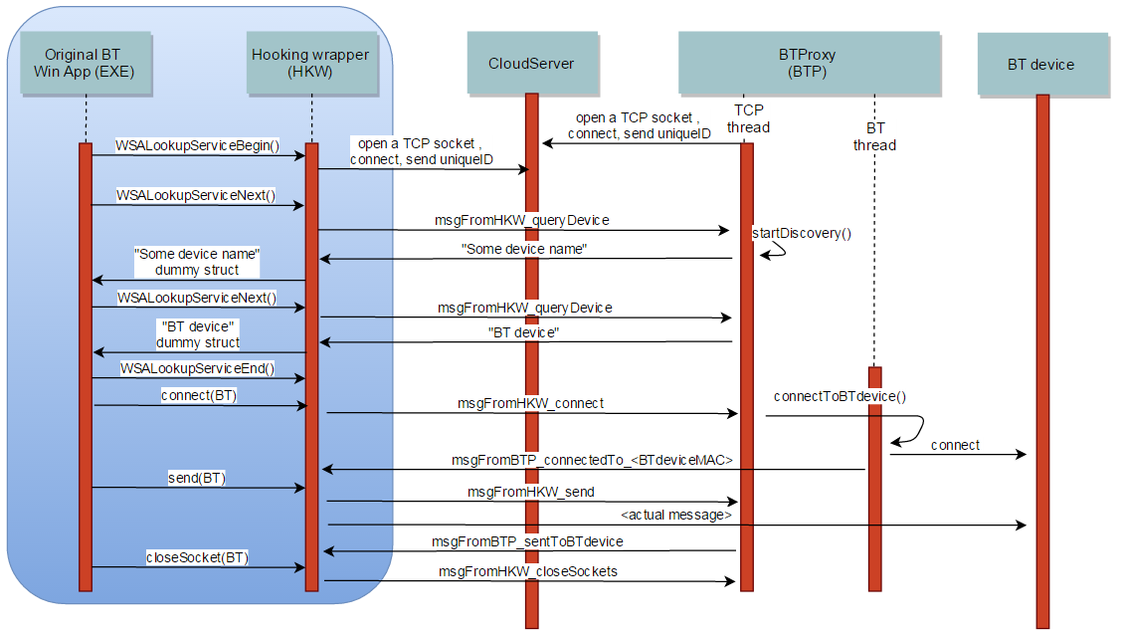
Complete flow

Slide 11
Special cases
BTP is not active
In case HKW is connected to CS, but BTP is not, CS notifies HKW.
HKW will call the original BT functions from now on.
Remote discovery fails
BTP holds a list of found devices. In case all devices were sent, “msgFromBTP_WSA_E_NO_MORE” is sent.
Two attempts for SDP are allowed by BTP (as discovery sometimes fails).
If both attempts fail, SDP is conducted by the local device (original Win app).

Slide 12
Special cases
Several BT devices in the same original BT app
It is required to identify whether the device is local or remote.
When HKW returns a found device dummy struct, MAC address is set to 0xAABBCCDDEEFF.
When hooked socket() function is called, if the MAC address is 0xAABBCCDDEEFF, the returned socket is the (already opened) TCP socket to CS.
Using this socket, it is possible to identify whether the device is remote or local.

Slide 13
Full system demonstration

Slide 14
What was learnt?
BT discovery procedure with Winsock and Android.
A taste of cloud computing.
Multi threaded programming on Windows and Android.

Slide 15

Questions?

Slide 16

Gratitude
Eli Meirom
Roy Miterany
Victor Kulikov
Hovav Gazit

Slide 17

Thanks!

